Slide 1
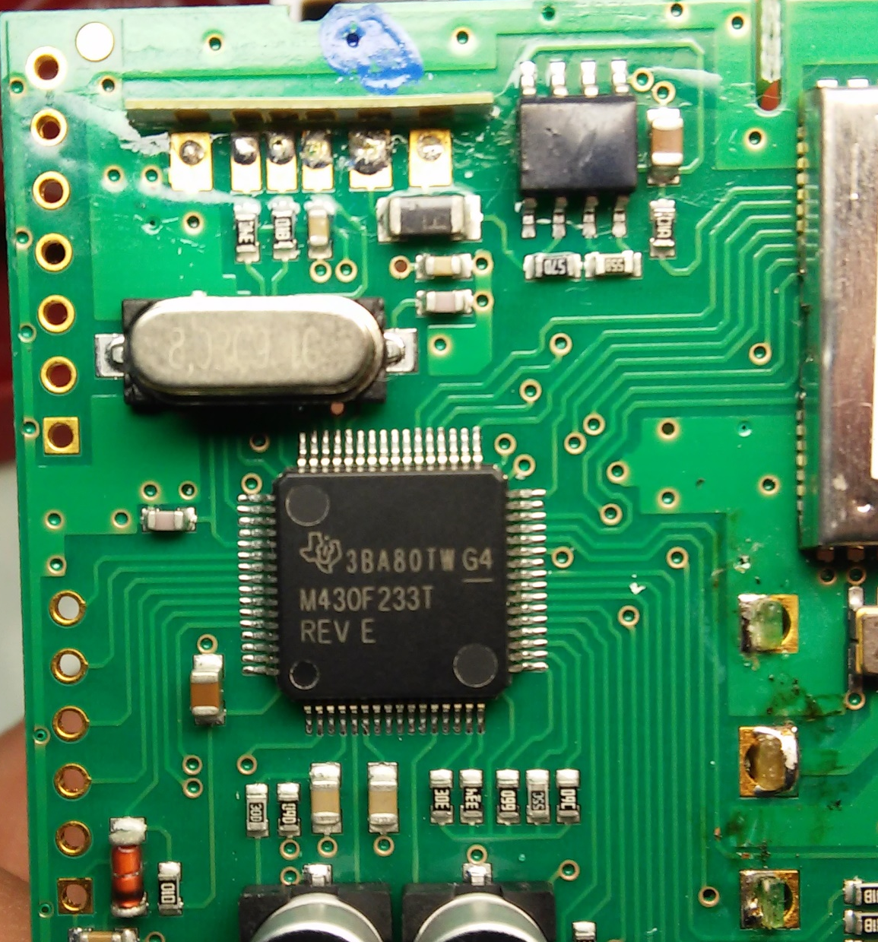
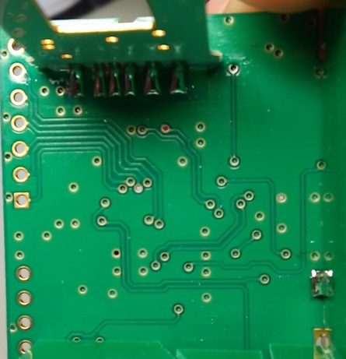
Finding Same VIAs

Slide 2
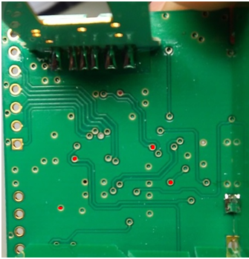
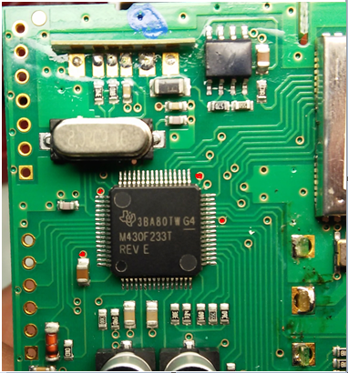
Solid Copy of Page 1. Individually

Slide 3
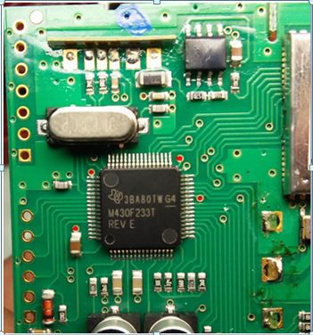

Slide 4
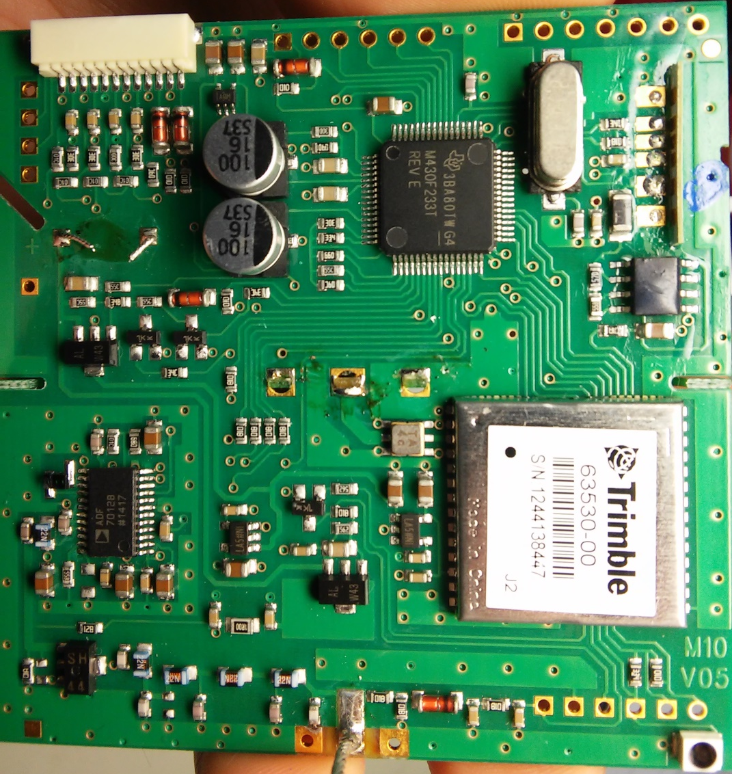
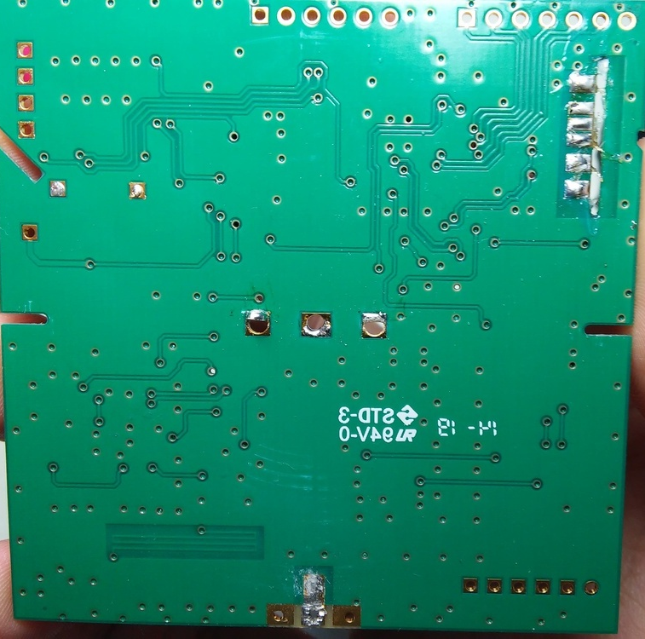
Whole PCB Matching ???

Slide 5
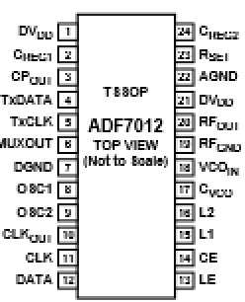
CVCO
DVDD
CREG2
CREG1
RSET
CPOUT
AGND
TxDATA
ADF 7012
DVDD
TxCLK
RFOUT
MUXOUT
RFGND
DGND
VCOIN
OCS1
CVCO
OSC2
L2
CLKOUT
L1
CLK
CE
DATA
LE

